Slide 1

KINETIQ
SAINTGITS
COLLEGE OF ENGINEERING (AUTONOMOUS)
RTOS-Based IoT Healthcare Assistant with Sensor-Grounded Voice AI
‘Mirror, Mirror’ — the wellness mirror that sees, listens and answers
Team: Sid & Tharun · Faculty Guide: (to be confirmed)
FINAL INTERNAL REVIEW — 15 Oct 2026
LEARN . GROW . EXCEL
SAINTGITS COLLEGE (AUTONOMOUS)

Slide 2
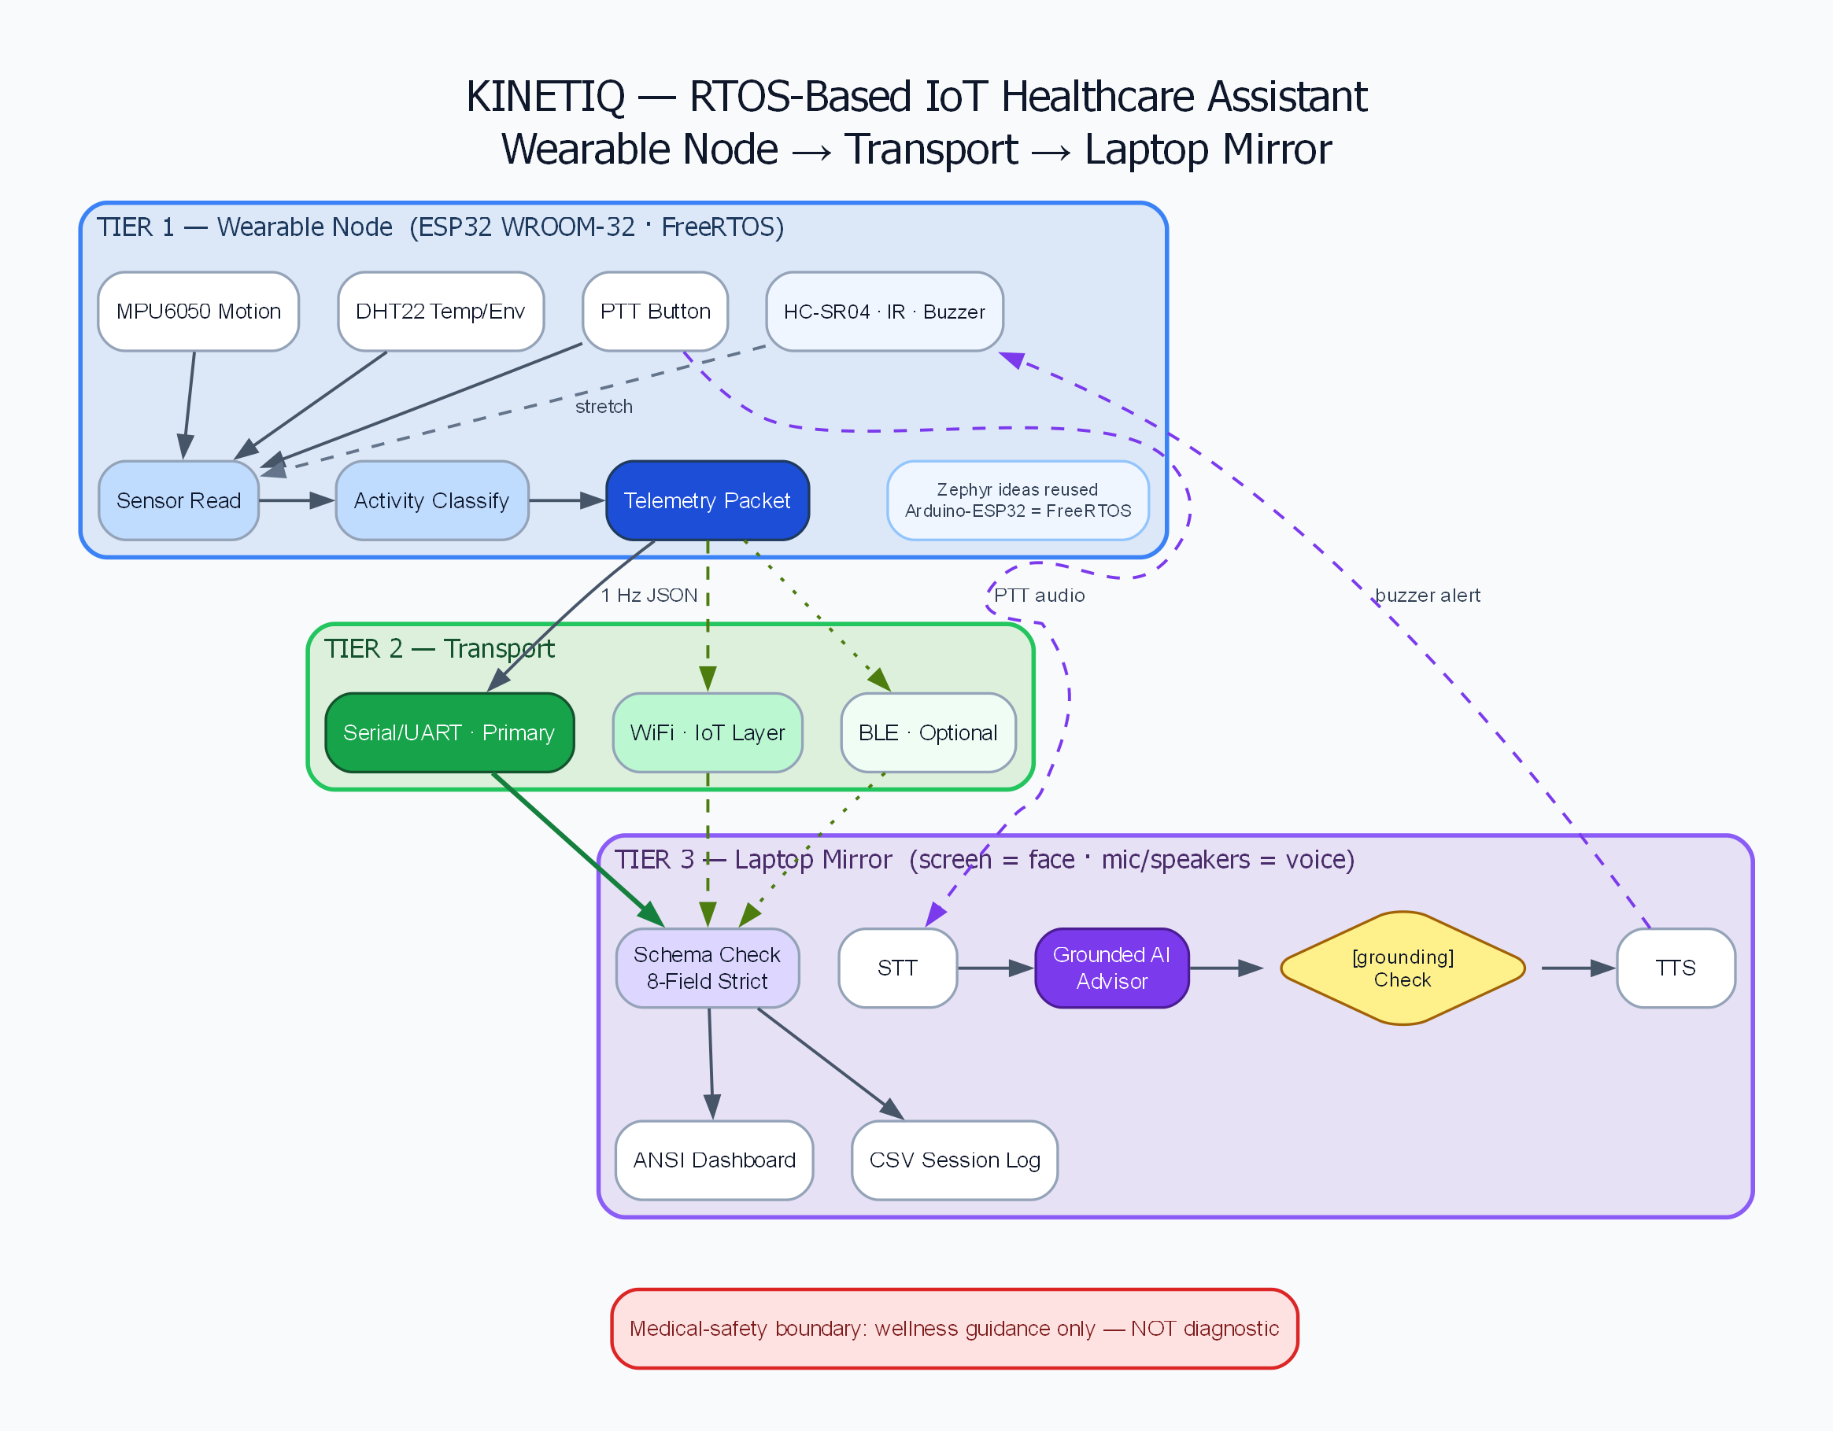
PROBLEM STATEMENT
• Wellness data is siloed inside wearables — no open export, no live feed a student system can build on.
• Generic voice and chat assistants hallucinate health advice; none of it is grounded in live physiology.
• Posture, sedentary-time and room-comfort risks go undetected in real time at the study desk.
• Classroom embedded work stops at demo boards — the RTOS-plus-IoT integration gap is the real learning gap.
• Scope is honest: no clinical claims. The need is an open, explainable wellness assistant that reacts to live sensor state — and says why.
System at a glance — sensing node to mirror. Full diagram in METHODOLOGY.
LEARN . GROW . EXCEL
SAINTGITS COLLEGE (AUTONOMOUS)

Slide 3
OBJECTIVES
1. RTOS SENSING NODE — FreeRTOS tasks plus queues on ESP32 (sensor / comms / alert tasks, vTaskDelay pacing, no delay() spaghetti).
2. IoT TELEMETRY PIPELINE — live newline-JSON stream off-device to the laptop dashboard and CSV log; serial first, WiFi bridge next.
3. EMBEDDED SENSOR DESIGN — I2C MPU6050 plus HC-SR04, DHT22 on GPIO13, button on GPIO4, buzzer on GPIO17; divider-protected echo pin.
4. SENSOR-GROUNDED VOICE AI — offline STT to LLM to TTS, every reply gated by verify_grounding against live telemetry; FAIL-closed.
SUCCESS GATE — serial-only demo frozen 20 Oct: the pass threshold even if WiFi slips; simulator plus recorded video as floor.
LEARN . GROW . EXCEL
SAINTGITS COLLEGE (AUTONOMOUS)

Slide 4
METHODOLOGY
SENSE
MPU6050·DHT22·sonar·cam
➔
PROCESS
queues·validate
➔
INFER
posture·rules
➔
COMMUNICATE
serial·WiFi·CSV
➔
ASSIST
voice·buzzer
• SENSE — MPU6050 motion, DHT22 room climate, HC-SR04 presence, webcam pose mesh.
• PROCESS — FreeRTOS sensor task samples, queue hands frames to comms task; schema validates every line.
• INFER — activity and exertion rules plus posture cross-check turn raw numbers into state.
• COMMUNICATE — newline-JSON over serial (WiFi bridge next) into dashboard, CSV log and voice context.
• ASSIST — grounded voice answer cites live values; buzzer plus voice cue on slouch.
LEARN . GROW . EXCEL
SAINTGITS COLLEGE (AUTONOMOUS)

Slide 5
DEMO — WHAT WORKS
$ dashboard --source stdin
dashboard: received=75 dropped=0
$ assistant "how am I doing?"
[grounding] PASS — cites live HR + posture
[llm] reply via ollama (gemma2:2b) — grounding PASS
$ ble bridge
ble: packets_routed=30 schema_rejected=0
$ voice pipeline
voice: stt→llm→tts pipeline OK
60-SECOND DEMO SCRIPT
1. Walk up to the mirror — camera sees posture; mirror greets you by state.
2. Slouch — voice says ‘sit up’ and the node buzzer fires.
3. Ask ‘how am I doing?’ — grounded voice answer plus [grounding] PASS on screen.
4. Dashboard behind shows the live RTOS node stream — the RTOS/IoT proof.
Counters (received/dropped, routed/rejected) stay visible: loss is shown, never silent.
LEARN . GROW . EXCEL
SAINTGITS COLLEGE (AUTONOMOUS)

Slide 6
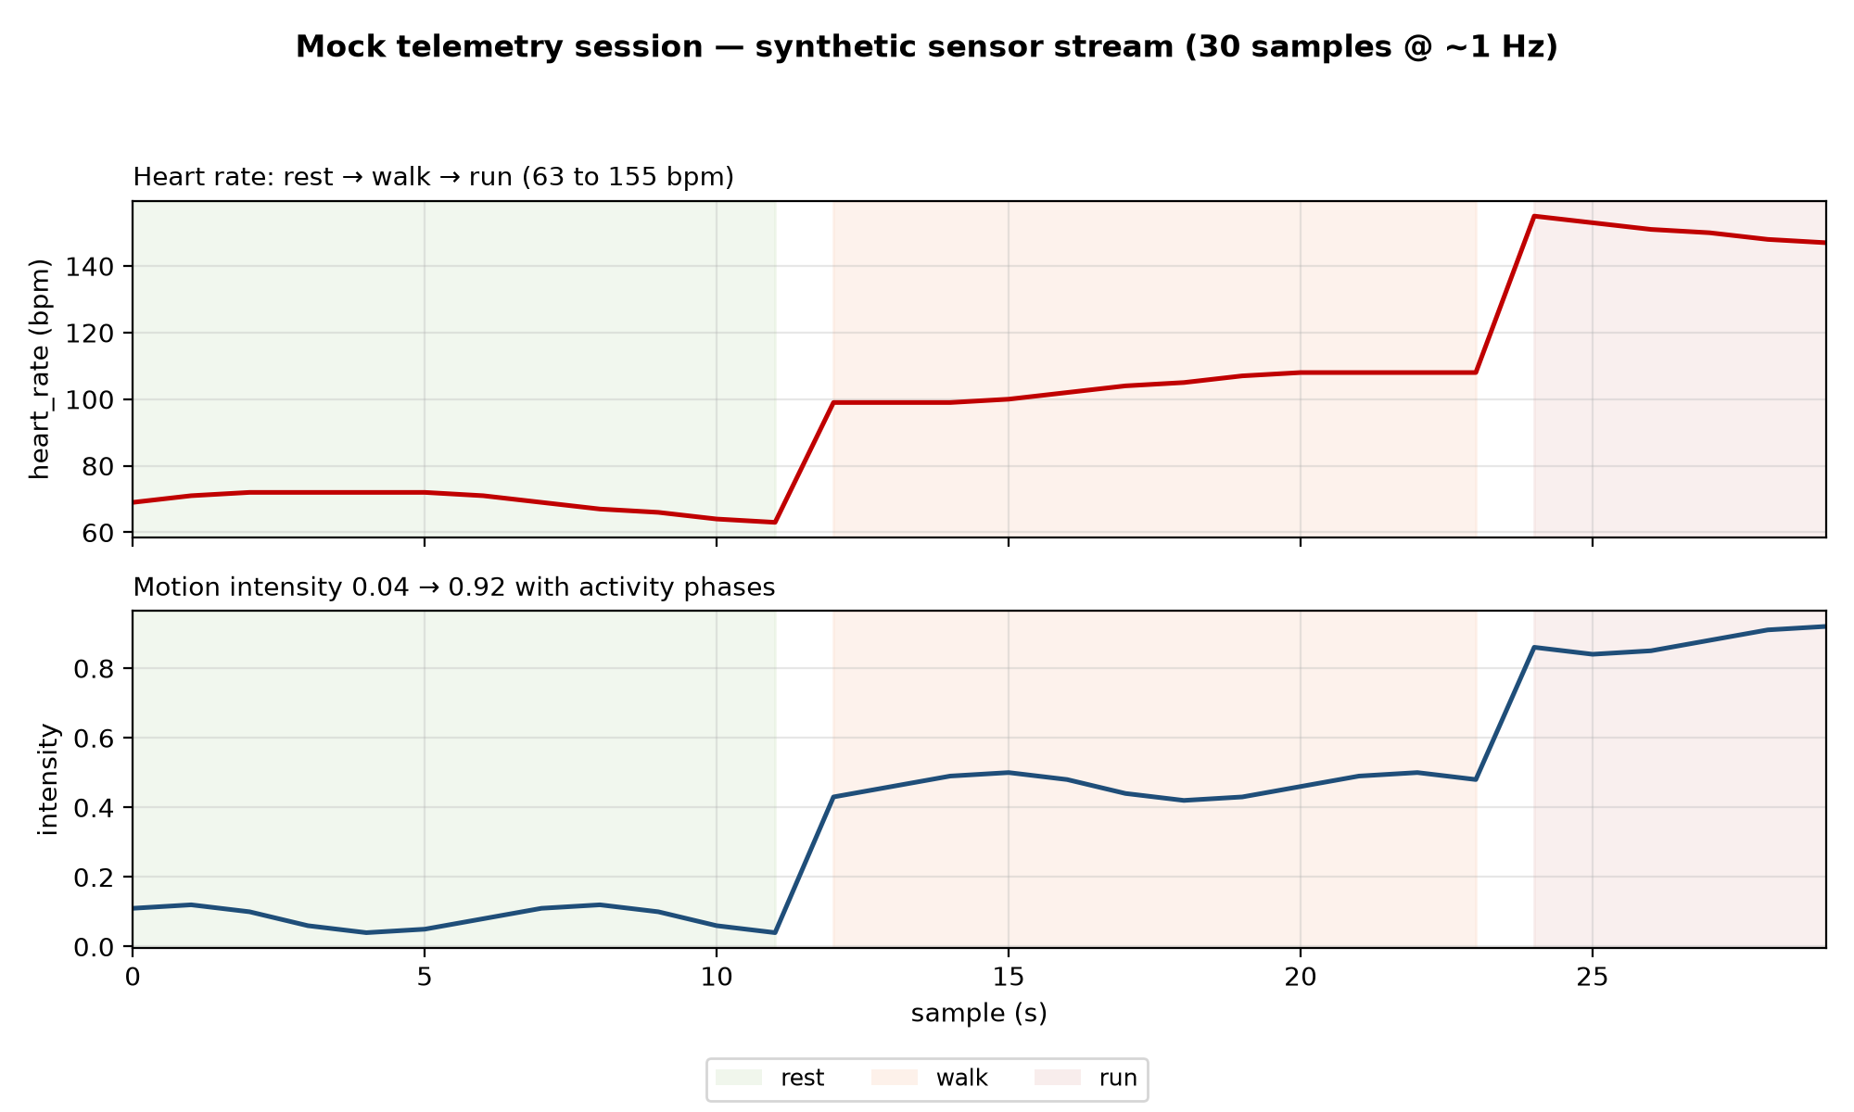
RESULTS
• Mock session session_20261014_193910: 30 samples at ~1 Hz, rest to walk to run.
• Heart rate 63 → 155 bpm tracks activity phases; motion intensity 0.04 → 0.92.
• Schema: 8-field strict validation (timestamp, heart_rate, spo2, activity, motion_intensity, exertion, steps, ppg_quality); rejects logged with reason.
• Dashboard: received-vs-dropped counters on every run; BLE bridge routed-vs-rejected likewise.
• Voice: real STT measured 0.48 s per clip (synthesized audio), total well under the 5.0 s gate; grounding verify is FAIL-closed — ungrounded replies are never spoken.
LEARN . GROW . EXCEL
SAINTGITS COLLEGE (AUTONOMOUS)

Slide 7
HARDWARE & BOM
# | ITEM | QTY | ₹ | STATUS
1 | ESP32 DevKit V1 WROOM-32 (headers pre-soldered) | 2 | 998 | Ordered
2 | Micro-USB data cables (drawer check first) | 2 | 0–300 | Ordered
3 | 830-pt breadboard + M-M jumper kit | 1 | 499 | Ordered
4 | MPU6050 + HC-SR04 + IR combo (headers soldered) | 1 | 470 | Ordered
5 | DHT22 module (built-in pullup) | 1 | 309 | Ordered
6 | F-F jumper 20-pack + tact buttons + caps + buzzer | — | 205 | Ordered
 | TIER-A TOTAL |  | ≈1,950 | Design-complete
PIN PLAN — I2C SDA=21 / SCL=22 (MPU 0x68) · DHT=GPIO13 · sonar Trig=26 / Echo=25 via 1k+2k2 divider · button=GPIO4 · buzzer=GPIO17 · LED=GPIO16.
Honest status: Wokwi browser sim + native FreeRTOS node (keyboard-driven) ✓ · physical units next week; HR/SpO2 via wearable bridge is a timeboxed stretch goal.
LEARN . GROW . EXCEL
SAINTGITS COLLEGE (AUTONOMOUS)

Slide 8
ROADMAP & THANK YOU
DAY | GATE | STATUS
12 Oct | Idea confirmed · order placed · Wokwi blink tonight | ✓ done
13 Oct | Firmware hardware-agnostic · bridge · backup video | ✓ done
14–15 | Board arrives · serial JSON to dashboard | → next
16 | I2C sensors live · figures + wiring | → next
17–18 | WiFi layer (soft-AP fallback ready) | → next
19–20 | Audio cut/go · serial demo FROZEN | → next
21–22 | Report · rehearse · PRESENT | → next
REFERENCES (MINI)
Zephyr / FreeRTOS task-queue model · ESP32 DevKit docs · RAG-grounding for sensor-cited answers · MediaPipe pose mesh.
THANK YOU — Questions?
github.com/siddoit/KinetiQ
LEARN . GROW . EXCEL
SAINTGITS COLLEGE (AUTONOMOUS)

